Slide 1

Group Discussions
© NEXT Link Pvt. Ltd., 23 & 24 Infantry Road, 2nd Floor, Bangalore, India 560 001, Phone:+91 (80) 4113 2600, www.nextindia.net This material is the property of NEXT Link Pvt. Ltd., and may not be used, distributed, stored, or copied in any form without the written permission of the copyright holder.

Slide 2
General Format
A topic is provided for discussion.
The topic can be anything, from current affairs to general issues.
The group is permitted to speak at will.
The duration of a group discussion will usually be one hour.
A panel of observers will assess the participants.
© NEXT Link Pvt. Ltd., 23 & 24 Infantry Road, 2nd Floor, Bangalore, India 560 001, Phone:+91 (80) 4113 2600, www.nextindia.net This material is the property of NEXT Link Pvt. Ltd., and may not be used, distributed, stored, or copied in any form without the written permission of the copyright holder.

Slide 3
Purpose
To hear you speak
To evaluate your communication skills
To observe your interactive skills
To assess your confidence
To judge your alertness, presence of mind, problem-solving ability
© NEXT Link Pvt. Ltd., 23 & 24 Infantry Road, 2nd Floor, Bangalore, India 560 001, Phone:+91 (80) 4113 2600, www.nextindia.net This material is the property of NEXT Link Pvt. Ltd., and may not be used, distributed, stored, or copied in any form without the written permission of the copyright holder.

Slide 4

Points of Evaluation
Verbal communication
Interpersonal skills
Quality of contribution
Teamwork
Leadership ability
© NEXT Link Pvt. Ltd., 23 & 24 Infantry Road, 2nd Floor, Bangalore, India 560 001, Phone:+91 (80) 4113 2600, www.nextindia.net This material is the property of NEXT Link Pvt. Ltd., and may not be used, distributed, stored, or copied in any form without the written permission of the copyright holder.

Slide 5

Do...
Participate actively
Express your honest thoughts
Think before talking
© NEXT Link Pvt. Ltd., 23 & 24 Infantry Road, 2nd Floor, Bangalore, India 560 001, Phone:+91 (80) 4113 2600, www.nextindia.net This material is the property of NEXT Link Pvt. Ltd., and may not be used, distributed, stored, or copied in any form without the written permission of the copyright holder.

Slide 6

Do...
Speak confidently
Speak audibly
Speak to the point
Maintain equal eye contact with the participants
© NEXT Link Pvt. Ltd., 23 & 24 Infantry Road, 2nd Floor, Bangalore, India 560 001, Phone:+91 (80) 4113 2600, www.nextindia.net This material is the property of NEXT Link Pvt. Ltd., and may not be used, distributed, stored, or copied in any form without the written permission of the copyright holder.

Slide 7

Do...
Enter the conversation by …
Agreeing
Adding to a point made
by someone else
Asking a question
Disagreeing (politely, stating your reasons)
© NEXT Link Pvt. Ltd., 23 & 24 Infantry Road, 2nd Floor, Bangalore, India 560 001, Phone:+91 (80) 4113 2600, www.nextindia.net This material is the property of NEXT Link Pvt. Ltd., and may not be used, distributed, stored, or copied in any form without the written permission of the copyright holder.

Slide 8

Don’t…
Hesitate
Take the topic off the track
Pretend to agree or disagree
with the topic
Gesticulate too much
Get carried away by the topic
© NEXT Link Pvt. Ltd., 23 & 24 Infantry Road, 2nd Floor, Bangalore, India 560 001, Phone:+91 (80) 4113 2600, www.nextindia.net This material is the property of NEXT Link Pvt. Ltd., and may not be used, distributed, stored, or copied in any form without the written permission of the copyright holder.

Slide 9

Some Tips
Take time to think before you speak.
In case of any doubt, ask another participant to clarify her or his point.
Speak only after you have thought about the subject.
© NEXT Link Pvt. Ltd., 23 & 24 Infantry Road, 2nd Floor, Bangalore, India 560 001, Phone:+91 (80) 4113 2600, www.nextindia.net This material is the property of NEXT Link Pvt. Ltd., and may not be used, distributed, stored, or copied in any form without the written permission of the copyright holder.

Slide 10

Some Tips
Enter the discussion by agreeing with someone else’s points, and move on to express your views.
Be patient and do not get angry or emotional. Remember that your patience may be a point of evaluation.
© NEXT Link Pvt. Ltd., 23 & 24 Infantry Road, 2nd Floor, Bangalore, India 560 001, Phone:+91 (80) 4113 2600, www.nextindia.net This material is the property of NEXT Link Pvt. Ltd., and may not be used, distributed, stored, or copied in any form without the written permission of the copyright holder.

Slide 11
Some Tips
Be polite and avoid using strong phrases to express your disagreement.
Speak precisely and concisely.
Opening a discussion is the best way to catch attention, but do this only if you are confident about the topic.
© NEXT Link Pvt. Ltd., 23 & 24 Infantry Road, 2nd Floor, Bangalore, India 560 001, Phone:+91 (80) 4113 2600, www.nextindia.net This material is the property of NEXT Link Pvt. Ltd., and may not be used, distributed, stored, or copied in any form without the written permission of the copyright holder.

Slide 12

Positive Behavior
Initiating
Clarifying
Encouraging
Amplifying
Sharing information
and opinions
Listening
© NEXT Link Pvt. Ltd., 23 & 24 Infantry Road, 2nd Floor, Bangalore, India 560 001, Phone:+91 (80) 4113 2600, www.nextindia.net This material is the property of NEXT Link Pvt. Ltd., and may not be used, distributed, stored, or copied in any form without the written permission of the copyright holder.

Slide 13

Negative behavior
Displaying aggression
Interrupting
Attention seeking
Abrupt Withdrawal
Blocking
© NEXT Link Pvt. Ltd., 23 & 24 Infantry Road, 2nd Floor, Bangalore, India 560 001, Phone:+91 (80) 4113 2600, www.nextindia.net This material is the property of NEXT Link Pvt. Ltd., and may not be used, distributed, stored, or copied in any form without the written permission of the copyright holder.

Slide 14
Avoidable Common Mistakes
Being too conscious of the observers
Talking too much or too little
Displaying negative emotions when opinions differ
Demonstrating that you are nervous
Using inappropriate non-verbal communication
© NEXT Link Pvt. Ltd., 23 & 24 Infantry Road, 2nd Floor, Bangalore, India 560 001, Phone:+91 (80) 4113 2600, www.nextindia.net This material is the property of NEXT Link Pvt. Ltd., and may not be used, distributed, stored, or copied in any form without the written permission of the copyright holder.

Slide 15

Remember
Participate
Think
Enter the discussion
Speak clearly
Be polite
Pay attention to other speakers
© NEXT Link Pvt. Ltd., 23 & 24 Infantry Road, 2nd Floor, Bangalore, India 560 001, Phone:+91 (80) 4113 2600, www.nextindia.net This material is the property of NEXT Link Pvt. Ltd., and may not be used, distributed, stored, or copied in any form without the written permission of the copyright holder.

Slide 16
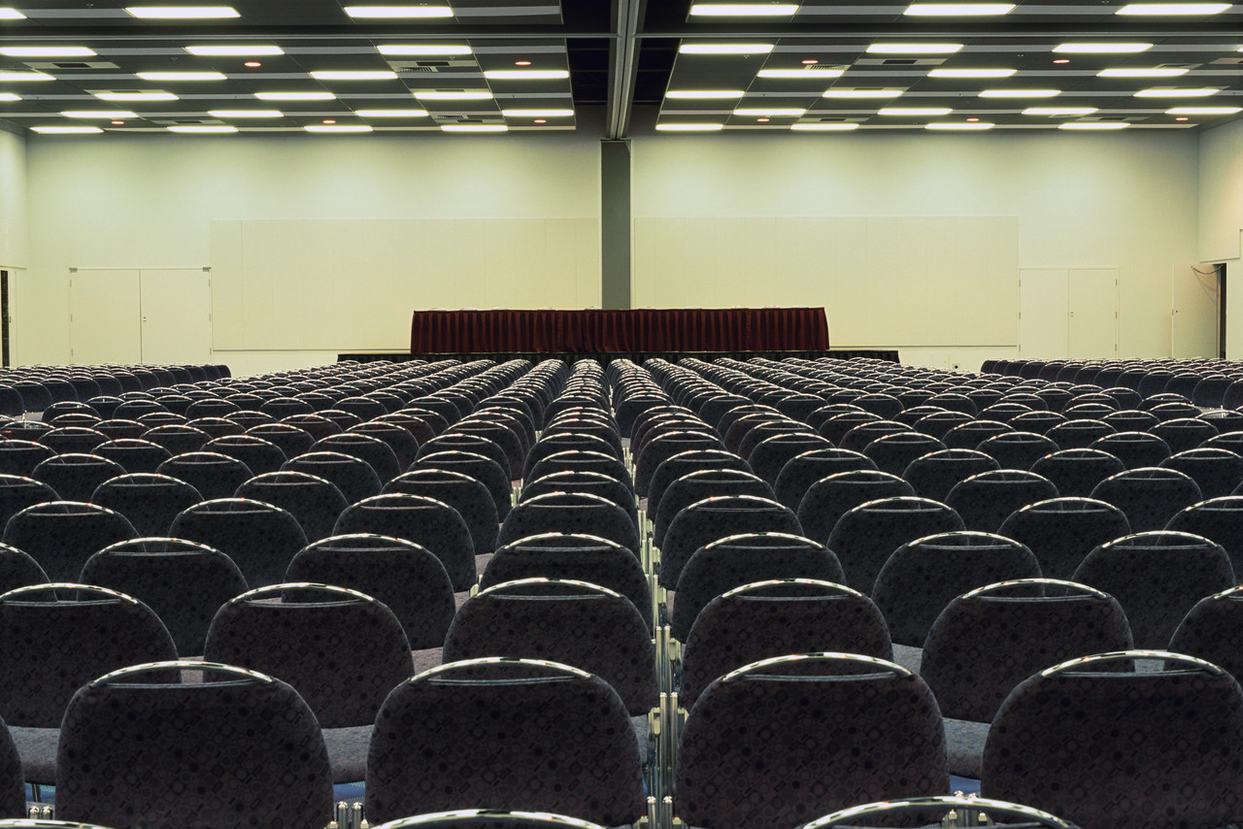
The End
© NEXT Link Pvt. Ltd., 23 & 24 Infantry Road, 2nd Floor, Bangalore, India 560 001, Phone:+91 (80) 4113 2600, www.nextindia.net This material is the property of NEXT Link Pvt. Ltd., and may not be used, distributed, stored, or copied in any form without the written permission of the copyright holder.

